Slide 1

Analog & Digital Waves
By Alex Joslin

Slide 2

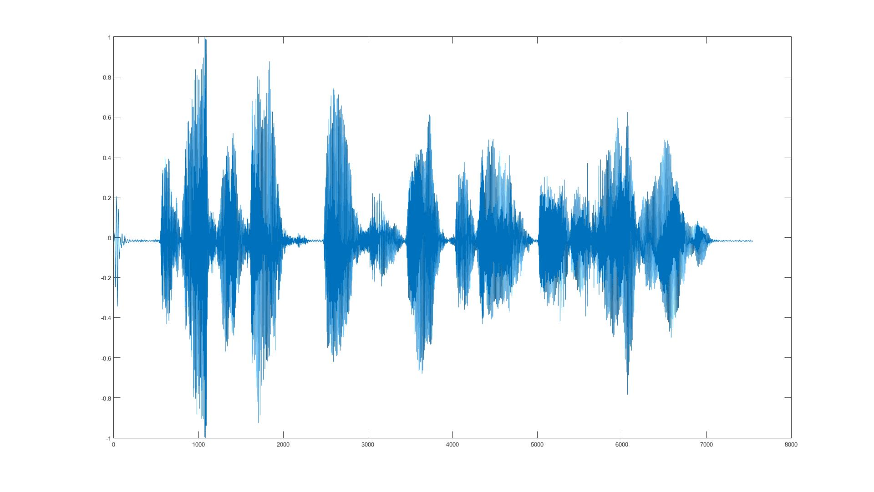
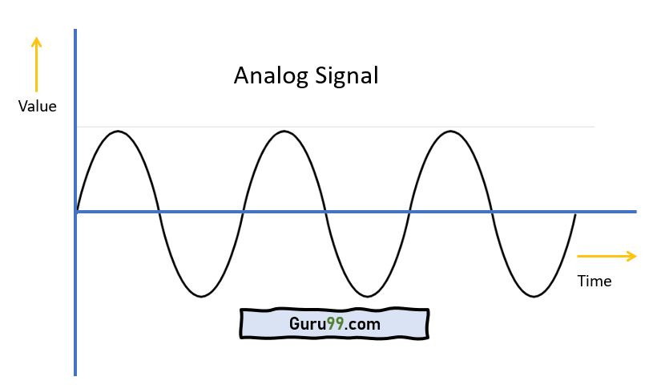
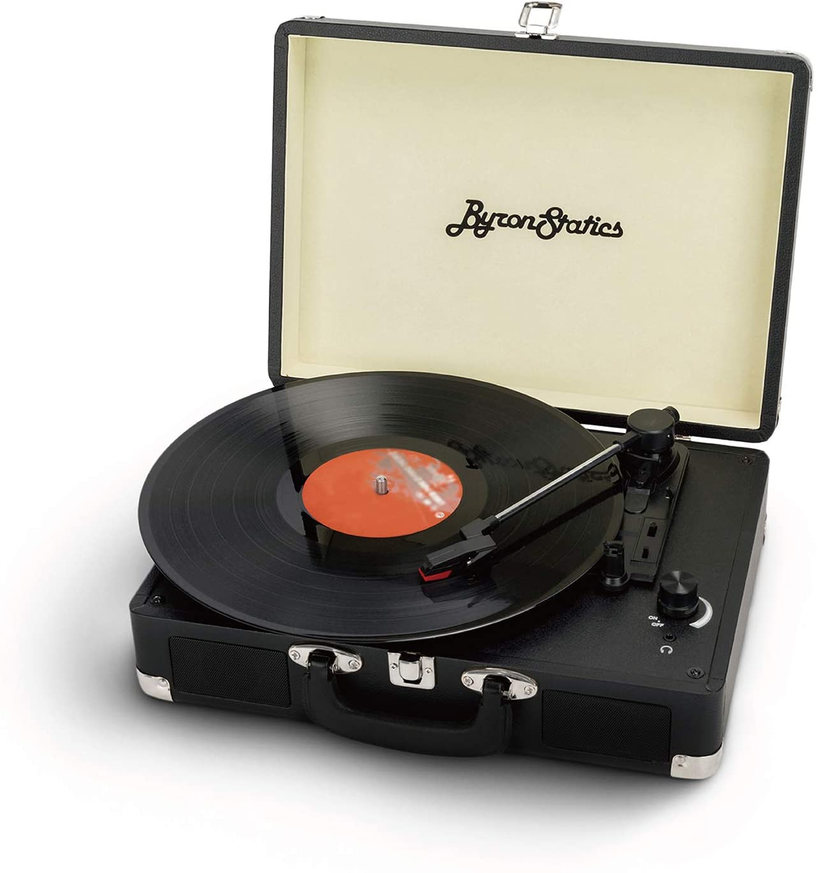
Analog Waves
Analog waves are smooth and continuous

Slide 3
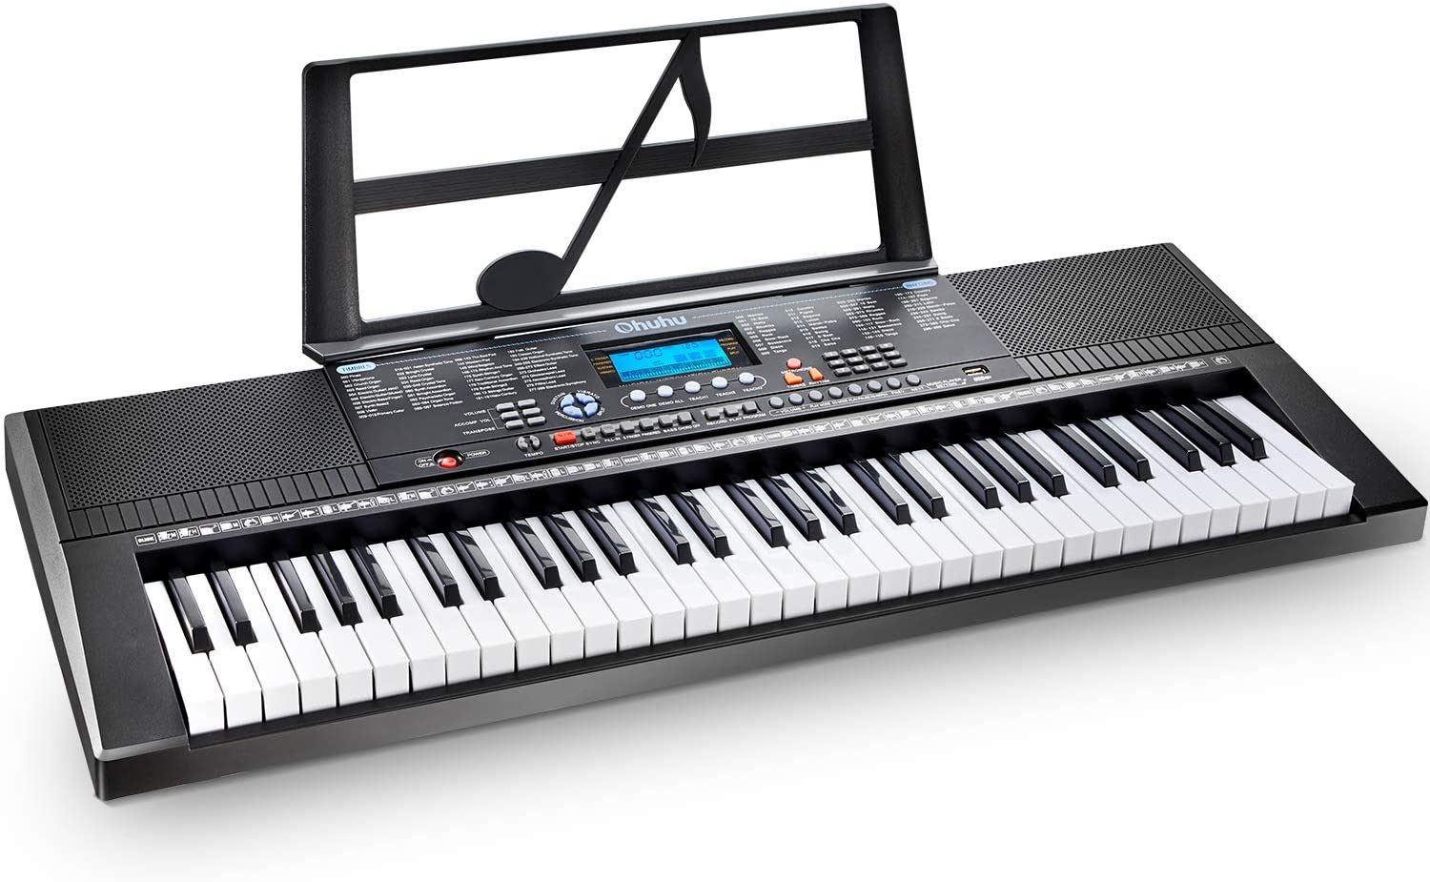
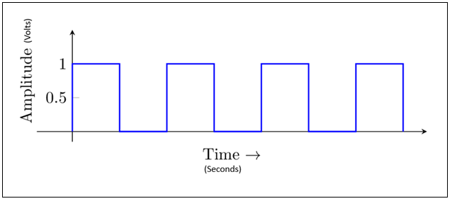

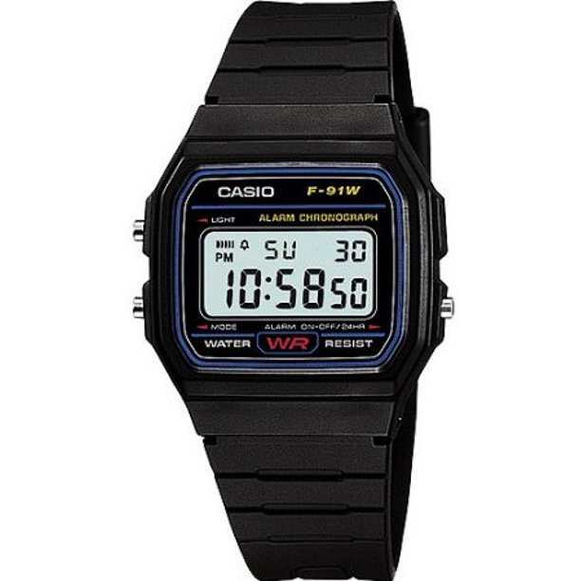
Digital Waves
Look like square waves and their value are either a 1 or a 0

Slide 4
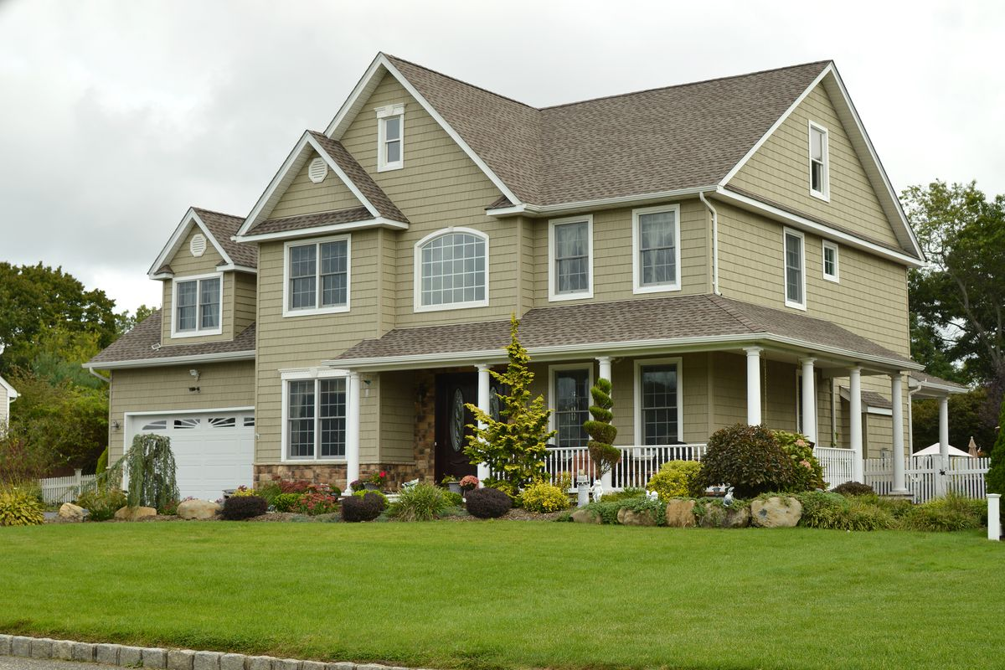
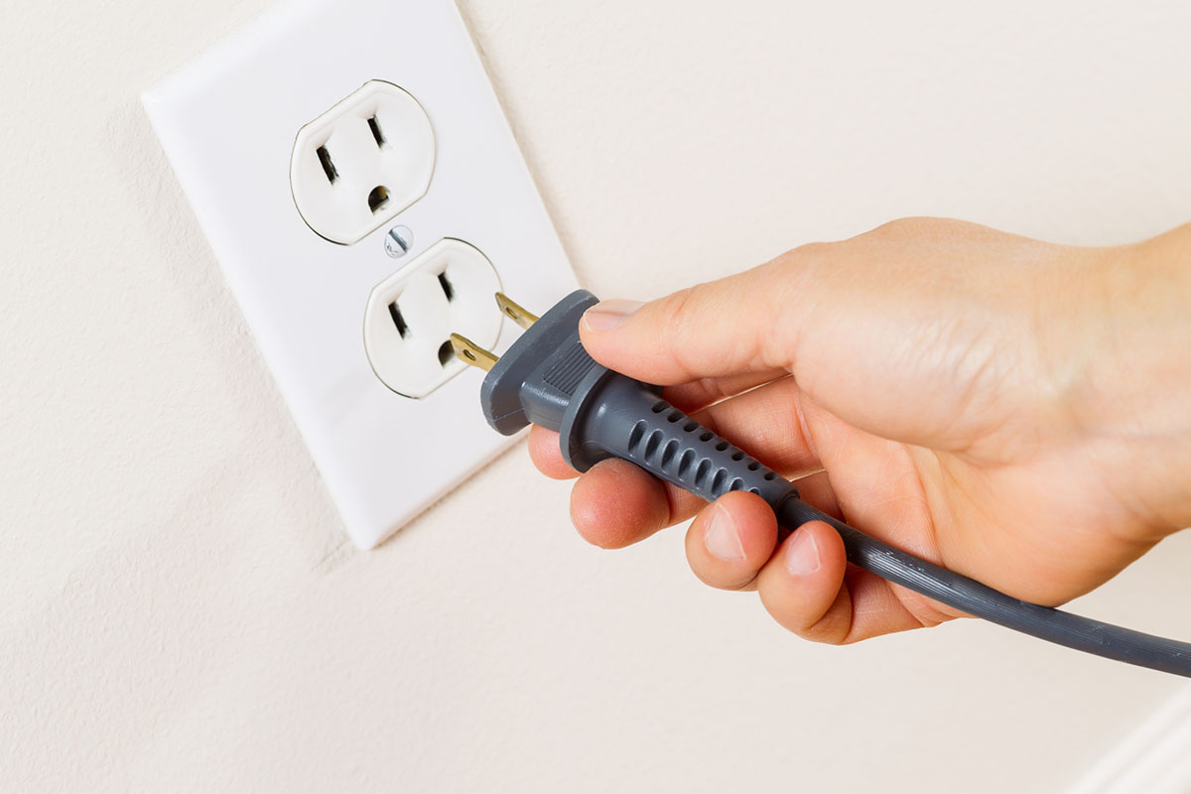
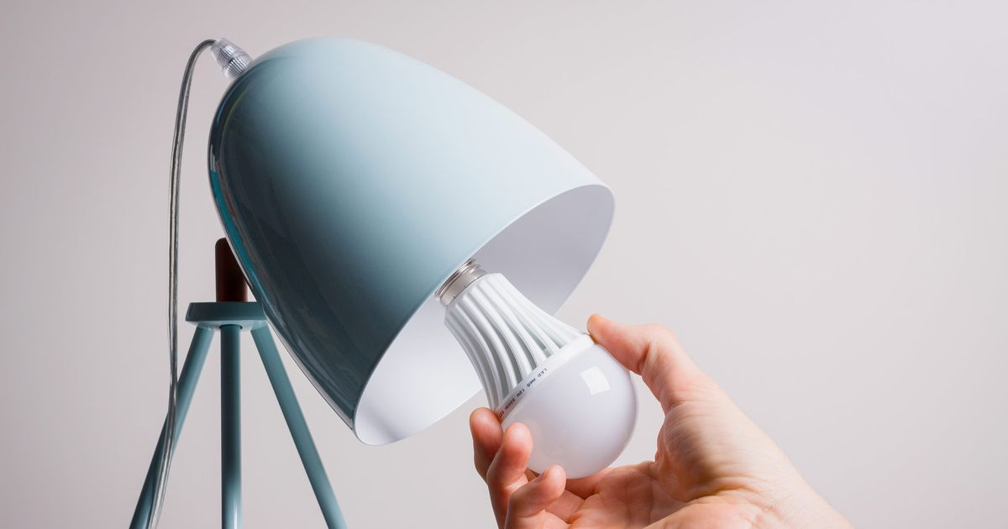
AC Power
Alternating Current is a type of current that changes directions back and forth.
This current is in the form of an analog wave
House Wall Socket (Frequency 60Hz)

Slide 5
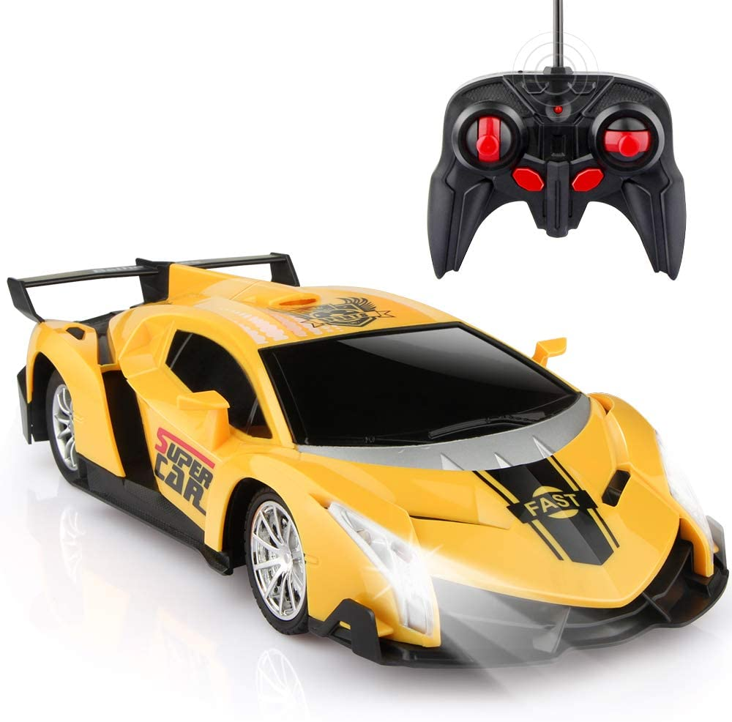


DC Power
Direct Current is a type of current that flows in one direction.
Frequency of DC is always 0 because it never changes in direction.

Slide 6
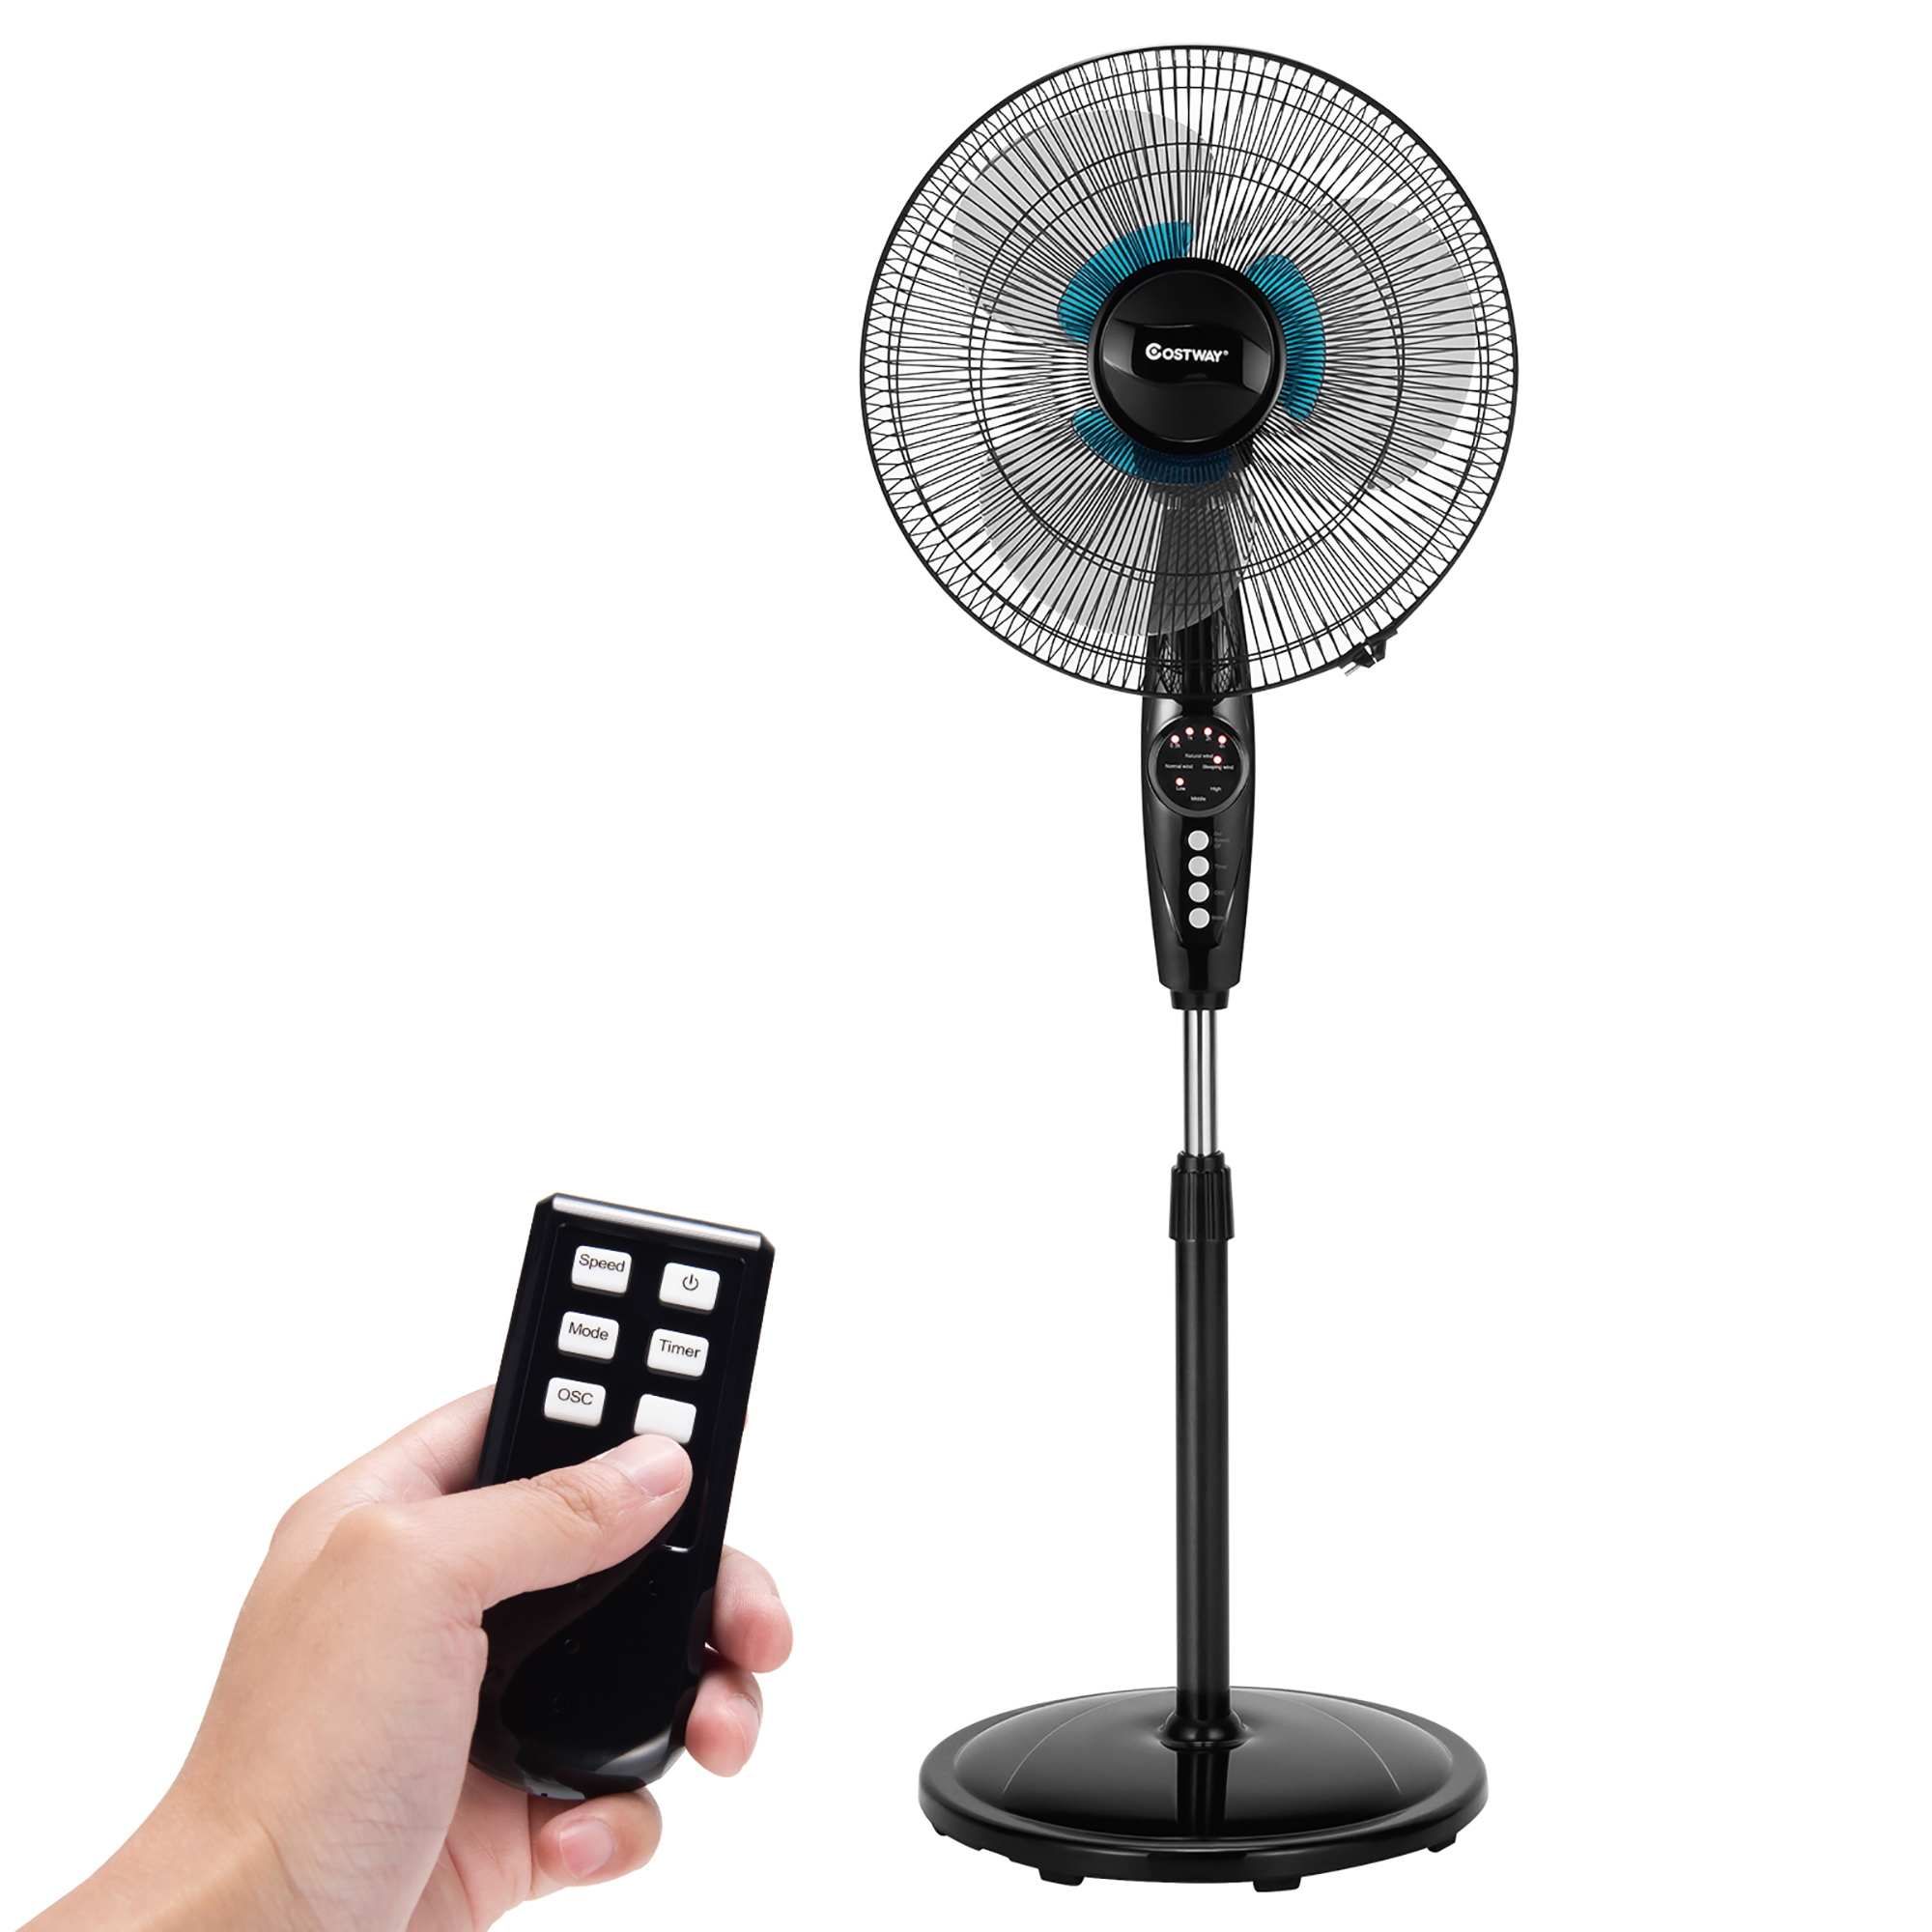
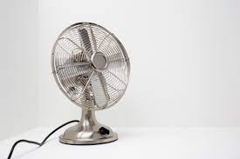
AC Power or DC Power?

Slide 7
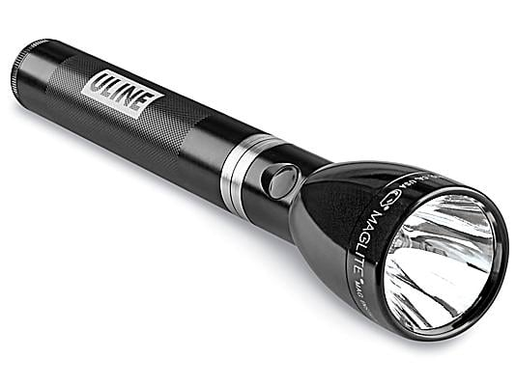
AC Power or DC Power?

Slide 8

AC Power or DC Power?

Slide 9

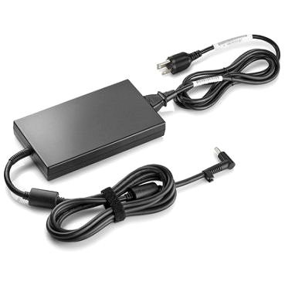
AC Power or DC Power?

Slide 10
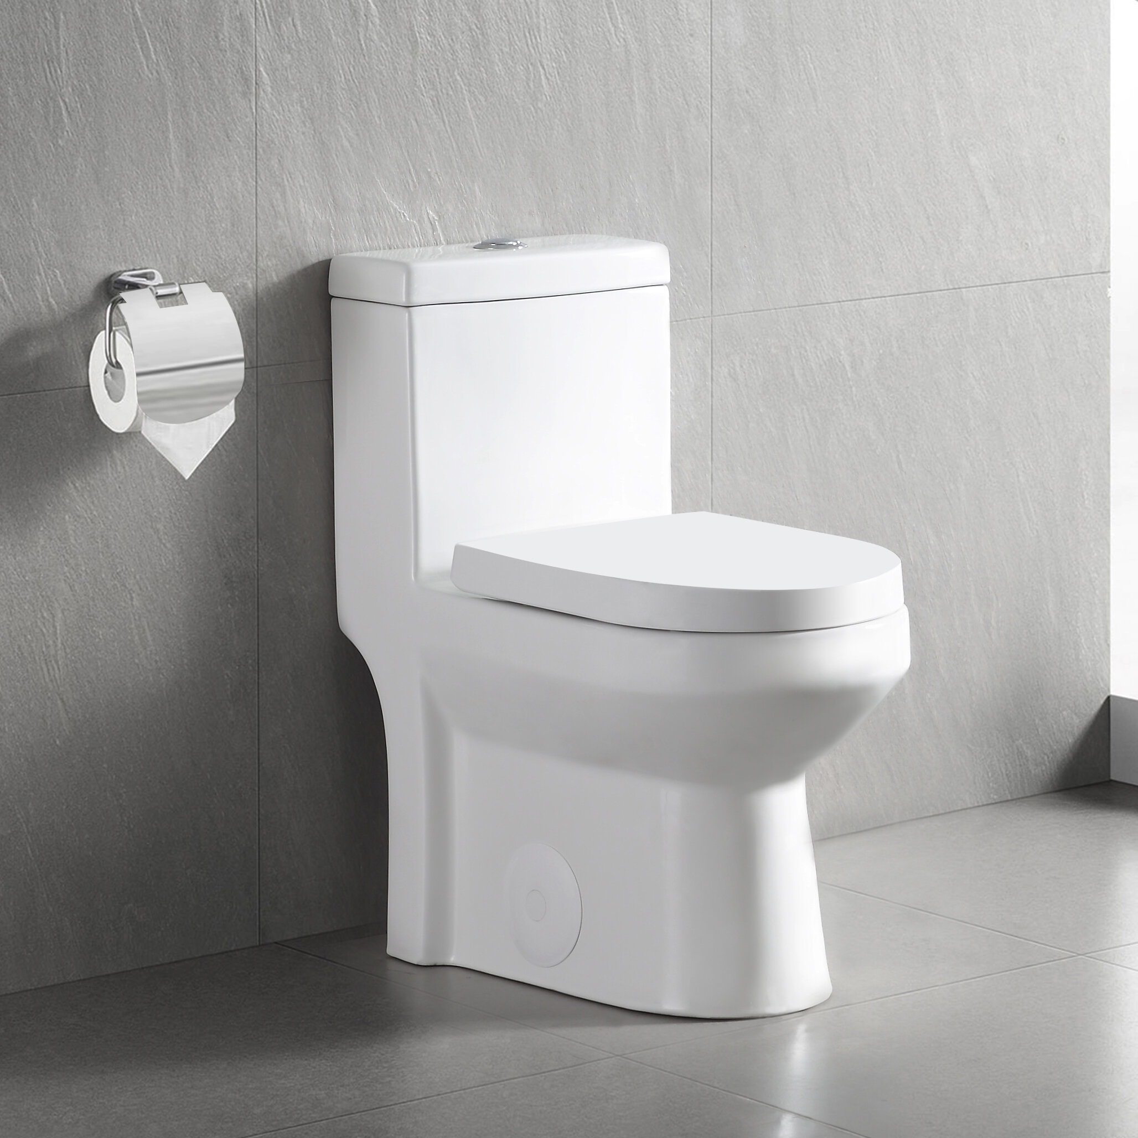
AC Power or DC Power?

Slide 11

Analog or Digital?

Slide 12

Analog or Digital?

Slide 13

Analog or Digital?

Slide 14

Analog or Digital?

Slide 15

Analog or Digital?

Slide 16
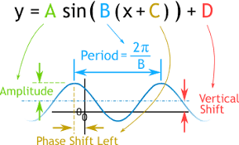
Analog Wave Equation?

